Slide 1
Introduction to Statistics for Data Analytics
© Oluwatosin Oluwadare, Ph.D. 2024
Department of Computer Science , University of Colorado, Colorado springs.
CS 2020 and dase 2020
Introduction to statistics for data analystics
Spring 2024
Lecture 11: Hypothesis Testing II
(Z-Test and T-test)

Slide 2

Program Overview Details

Slide 3
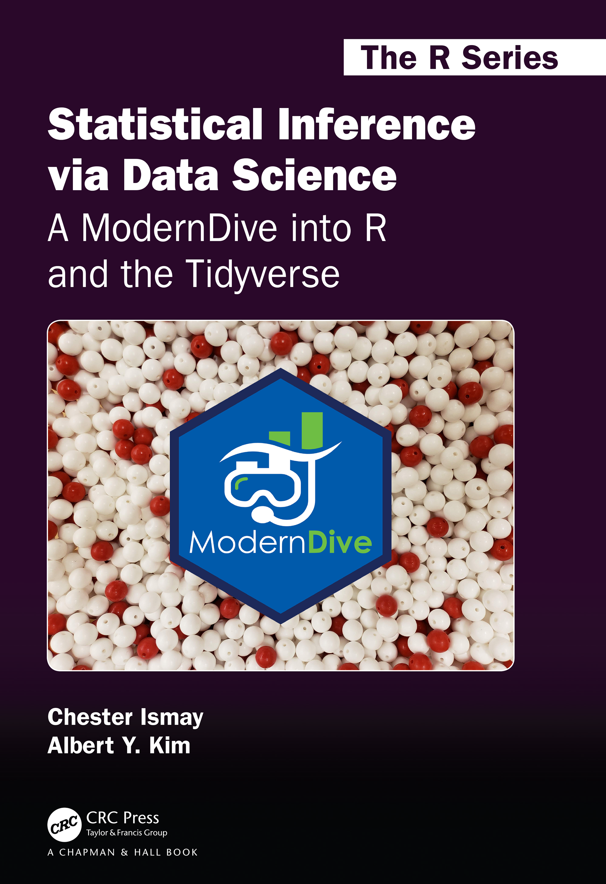
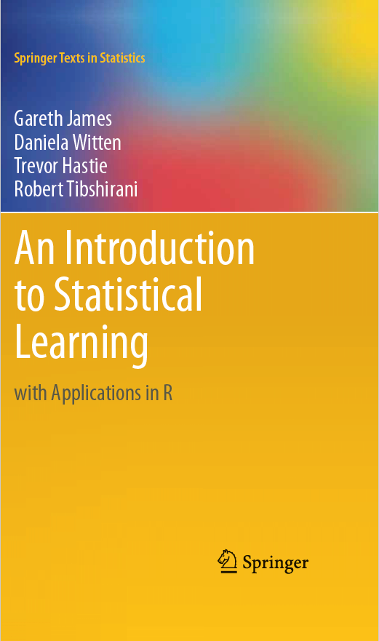
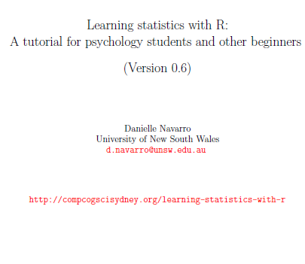
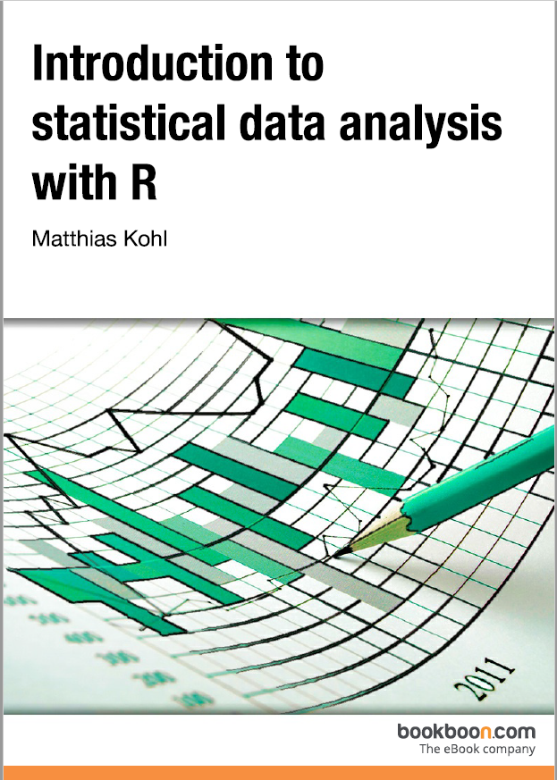
Credits
Our Main Textbook for the course:
  Ismay, Chester, and Albert Y. Kim. Statistical inference via data science: A ModernDive into R and the tidyverse. Chapman and Hall/CRC, 2019. Get an electronic copy from the UCCS Library. Or
  See open source copy of the textbook here: https://moderndive.com/ .
CS 2020 shared Resource from Dr. Atyabi
Introduction to SAS. UCLA: Statistical Consulting Group. from https://stats.oarc.ucla.edu/sas/modules/introduction-to-the-features-of-sas/ (accessed August 22, 2021).

Slide 4
Outline
Lecture 11
Decision rule: Two-Tailed test vs. One-Tailed Test
Comparing two means
The one-sample t-test
The independent samples t-test (Student test)
The independent samples t-test (Welch test)
The paired-samples t-test
One sided tests
Using the t.test() function
Effect size
Checking the normality of a sample
Testing non-normal data with Wilcoxon tests

Slide 5
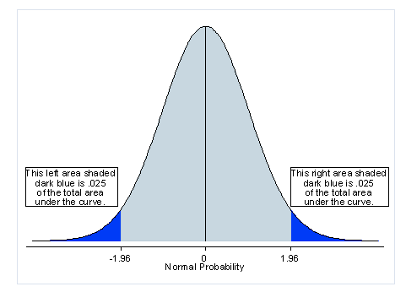
What is a two-tailed test?
A two-tailed test allots half of its alpha to testing the statistical significance in one direction and half of it to testing the significance in the other direction, regardless of the direction of the relationship.
It tests both if the mean is significantly greater than x or if the mean significantly less than x.
It tests for the possibility of positive or negative differences.
  For instance, if you want to see if Group A scored higher or lower than Group B, then you would want to use a two-tailed test.
Notes:
Introduction to SAS. UCLA: Statistical Consulting Group. from https://stats.oarc.ucla.edu/sas/modules/introduction-to-the-features-of-sas/ (accessed August 22, 2021).

Slide 6
What is a two-tailed test?
If you are using a significance level of 0.05. This means that .025 is in each tail of the distribution of your test statistic.
The mean is considered significantly different from x if the test statistic is in the top 2.5% or bottom 2.5% of its probability distribution, resulting in a p-value less than 0.05.
Notes:
Introduction to SAS. UCLA: Statistical Consulting Group. from https://stats.oarc.ucla.edu/sas/modules/introduction-to-the-features-of-sas/ (accessed August 22, 2021).

Slide 7
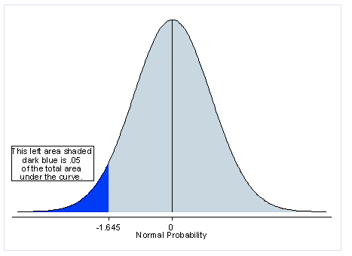
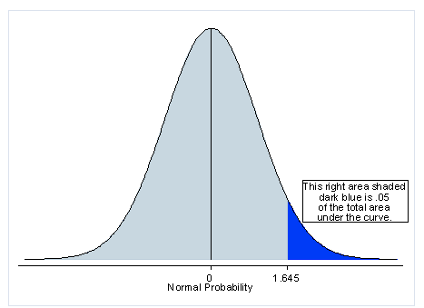
What is a one-tailed test?
If you are using a significance level of .05, a one-tailed test allots all of your alpha to testing the statistical significance in the one direction of interest.
When using a one-tailed test, you are testing for the possibility of the relationship in one direction and completely disregarding the possibility of a relationship in the other direction
Notes:
Introduction to SAS. UCLA: Statistical Consulting Group. from https://stats.oarc.ucla.edu/sas/modules/introduction-to-the-features-of-sas/ (accessed August 22, 2021).

Slide 8
What is a one-tailed test?
A one-tailed test is appropriate if you only want to determine if there is a difference between groups in a specific direction.
So, if you are only interested in determining if Group A scored higher than Group B, and you are completely uninterested in possibility of Group A scoring lower than Group B, then you may want to use a one-tailed test.
The main advantage of using a one-tailed test is that it has more statistical power than a two-tailed test at the same significance (alpha) level.
  The one-tailed test provides more power to detect an effect in one direction by not testing the effect in the other direction.
Notes:
One-tailed tests have better statistical power than two-tailed tests at the same level of significance (alpha), which is their principal advantage. In other words, if there really is a difference between the groups in the way you have predicted, your results are more likely to be significant for a one-tailed test. This is so because the test only considers one tail of the distribution.
https://www.statisticssolutions.com/should-you-use-a-one-tailed-test-or-a-two-tailed-test-for-your-data-analysis/#:~:text=This%20is%20because%20a%20two,groups%20in%20a%20specific%20direction.
Introduction to SAS. UCLA: Statistical Consulting Group. from https://stats.oarc.ucla.edu/sas/modules/introduction-to-the-features-of-sas/ (accessed August 22, 2021).

Slide 9
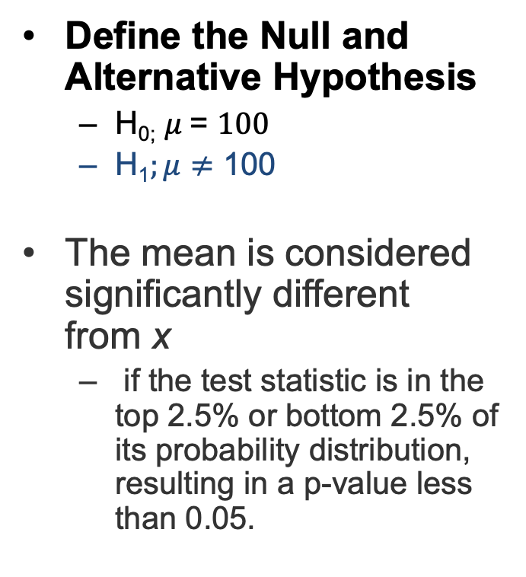
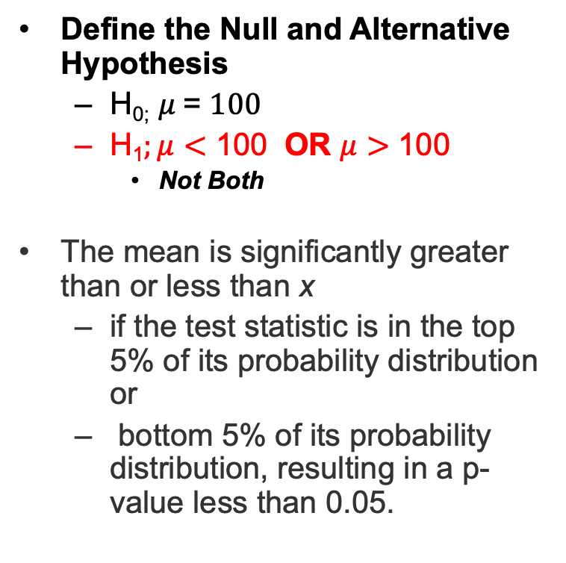
Two-tailed test vs. One-tailed Test
Define the Null and Alternative Hypothesis
  H_{0;} $μ$= $100$
  H₁$;μ≠$ 100
The mean is considered significantly different from x
  if the test statistic is in the top 2.5% or bottom 2.5% of its probability distribution, resulting in a p-value less than 0.05.
Define the Null and Alternative Hypothesis
  H_{0;} $μ$= $100$
  H₁$;μ<$ 100 OR $μ>$ 100
    Not Both
The mean is significantly greater than or less than x
  if the test statistic is in the top 5% of its probability distribution or
  bottom 5% of its probability distribution, resulting in a p-value less than 0.05.
Notes:
Introduction to SAS. UCLA: Statistical Consulting Group. from https://stats.oarc.ucla.edu/sas/modules/introduction-to-the-features-of-sas/ (accessed August 22, 2021).

Slide 10
When to use one-tailed test?
While it is tempting to use one-tailed test as it provided more power to detect an effect in one direction. The most important factor to consider is that you must beware of the consequences on missing an effect in other direction.
An example of a potential adverse effect: Drug development improvement than existing version.
After careful consideration, You can proceed with a one-tailed test if you weigh the repercussions of missing an effect in the untested direction and determine that they are minimal and in no way irresponsible or immoral.
  Drug development improvement not less effective.
Notes:
Introduction to SAS. UCLA: Statistical Consulting Group. from https://stats.oarc.ucla.edu/sas/modules/introduction-to-the-features-of-sas/ (accessed August 22, 2021).

Slide 11
When a one-tailed test is NOT appropriate
It is inappropriate to use a one-tailed test solely to achieve significance.
No matter how "close" to significant the two-tailed test was, choosing a one-tailed test after running a two-tailed test that failed to reject the null hypothesis is not suitable.
Inappropriate use of statistical tests might result in unreliable and very dubious results, which is a big price to pay for a significance star in your results table.
Notes:
Introduction to SAS. UCLA: Statistical Consulting Group. from https://stats.oarc.ucla.edu/sas/modules/introduction-to-the-features-of-sas/ (accessed August 22, 2021).

Slide 12
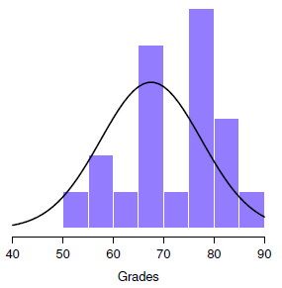
The One-sample z-test
> load( "zeppo.Rdata" )
> print( grades )
[1] 50 60 60 64 66 66 67 69 70 74 76 76 77 79 79 79 81 82 82 89
> mean( grades )
[1] 72.3

Slide 13
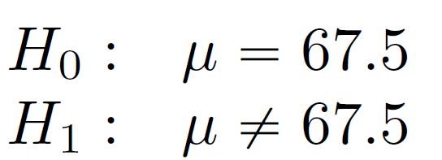
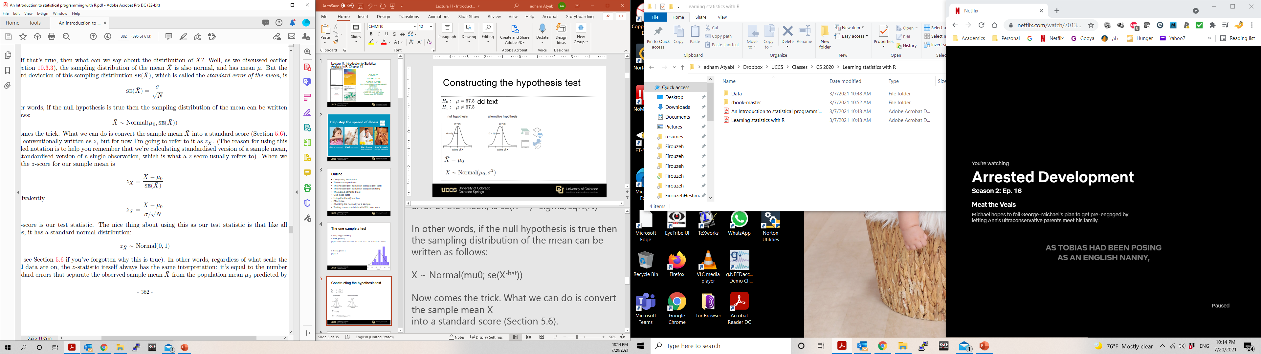
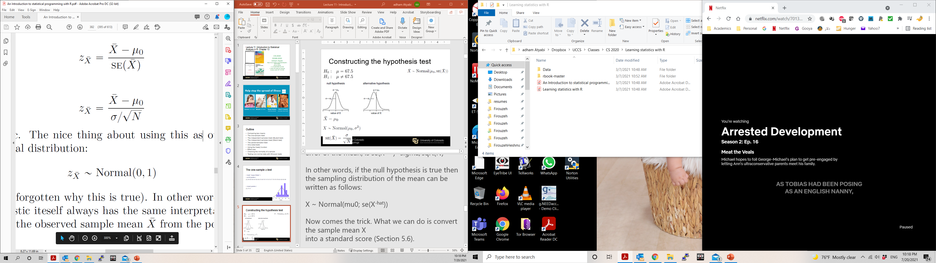
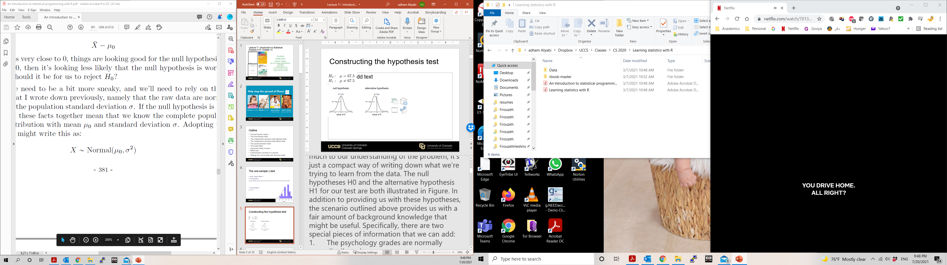

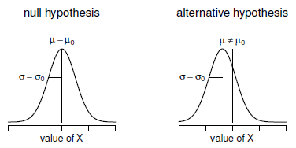

Constructing the hypothesis test

Slide 14
A worked example using R – Solution 1
> sample.mean <- mean( grades )
> print( sample.mean )
[1] 72.3
> mu.null <- 67.5
> sd.true <- 9.5
> N <- length( grades )
> print( N )
[1] 20
> sem.true <- sd.true / sqrt(N)
> print(sem.true)
[1] 2.124265
> z.score <- (sample.mean - mu.null) / sem.true
> print( z.score )
[1] 2.259606
We compute the critical values at 0.05 significance level.
> alpha = .05
> z.half.alpha = qnorm(1−alpha/2)
> c(−z.half.alpha, z.half.alpha)
[1] -1.959964 1.959964
Answer:
The test statistic 2.259606 lies in the and 1.9600 critical region. Hence, at .05 significance level, we do reject the null hypothesis

Slide 15
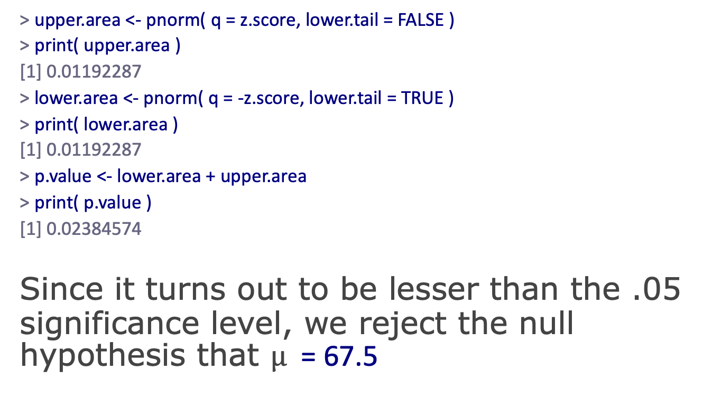
A worked example using R – Solution 2
> upper.area <- pnorm( q = z.score, lower.tail = FALSE )
> print( upper.area )
[1] 0.01192287
> lower.area <- pnorm( q = -z.score, lower.tail = TRUE )
> print( lower.area )
[1] 0.01192287
> p.value <- lower.area + upper.area
> print( p.value )
[1] 0.02384574
Since it turns out to be lesser than the .05 significance level, we reject the null hypothesis that $μ$ = 67.5

Slide 16
Assumptions of the z-test
Normality: z-test assumes that the true population distribution is normal
Independence: z-test assumes that the observations in the data set are not correlated with each other.
Known standard deviation. z-test assumes that the true standard deviation of the population is known to the researcher.
  In order to use a z-score, you need to know the mean μ and also the population standard deviation σ.

Slide 17
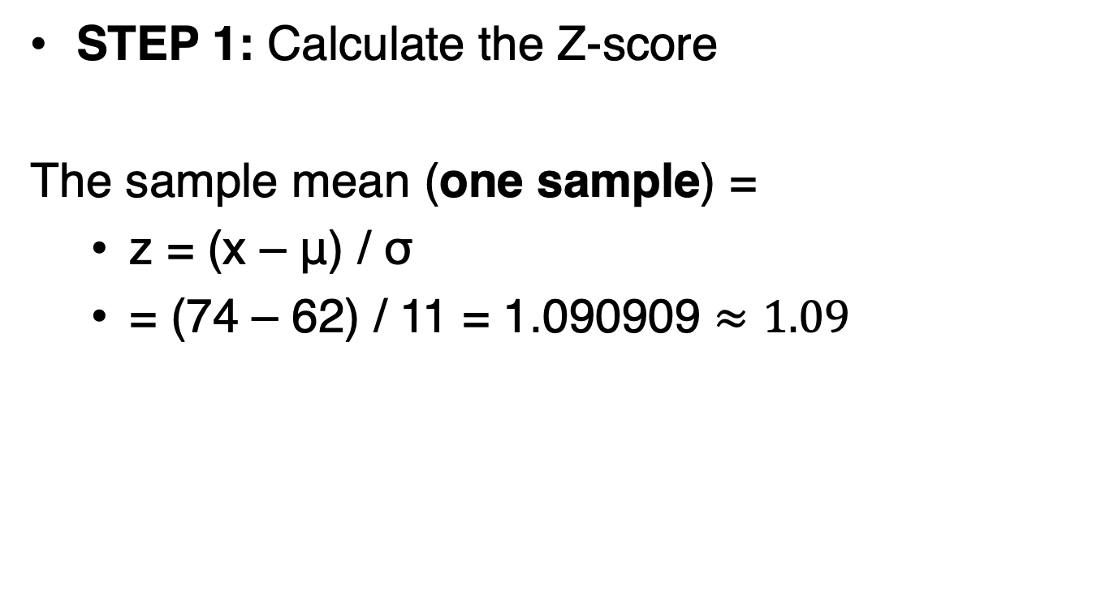
Consider IQ Example Test
STEP 1: Calculate the Z-score
The sample mean (one sample) =
  z = (x – μ) / σ
  = (74 – 62) / 11 = 1.090909 $≈1.09$
  Multiple samples: z = (x – μ) / (σ / √n)
Notes:
Get Z-score Table here: https://www.math.arizona.edu/~rsims/ma464/standardnormaltable.pdf

Slide 18
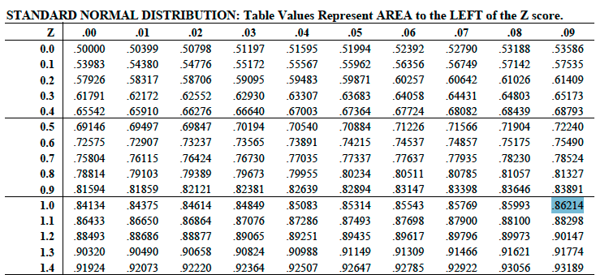
Consider IQ Example Test
STEP 2: Find the area corresponding to the z-score

Slide 19
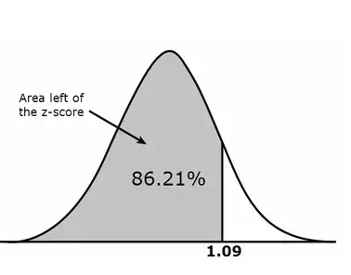
Consider IQ Example Test
STEP 3: Draw a valid conclusion
The area that we looked up in the z-table suggests that the student received a better score than 86% of the volunteers who took the IQ test.

Slide 20
Z-Score Interpretation
Teaching Evaluation:
You can use the z-table and the normal distribution graph to give you a visual about how a z-score of +2.0 means “higher than average”.
Let’s say a professor receives a teaching evaluation of score (3), and you know their z-score is 2.0.
You know that +2.0 is above average (because of the high placement on the normal distribution curve), but you want to know how much above average is this weight?

Slide 21
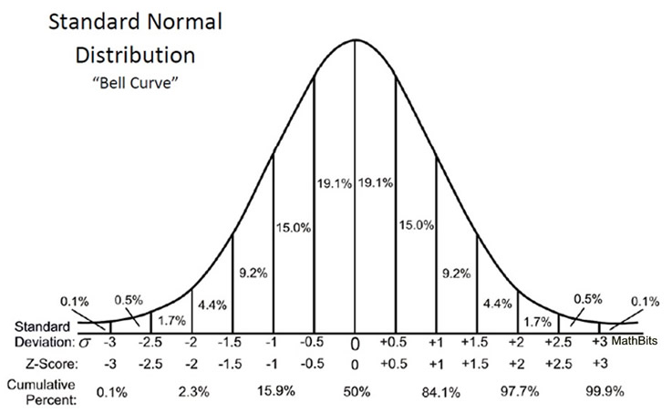
Another Example: Interpretation
Looking at the z-table:
The table below shows a z-score of 2.0 highlighted, showing .9772 (which converts to 97.72%).
97.72 % of the population score lie below that particular score and 100% – 97.72% = 2.28% of the scores lie above that score.
Hence, just 2.28% of the population is above the professor’s score.
  Could be concluded that the professor can be considered better than most .

Slide 22
One sample z-test: Consider IQ exam
In the population, the average IQ is 100 with a standard deviation of 15. A team of scientists wants to test a new medication to see if it has either a positive or negative effect on intelligence, or no effect at all. A sample of 30 participants who have taken the medication has a mean of 140. Did the medication affect intelligence?
Steps to Answer:
Define the Null and alternative Hypothesis
State Alpha
State Decision Rule
Calculate the Test statistics
State Results
Conclude and interpret the result
Notes:
Reference:
https://www.youtube.com/watch?v=BWJRsY-G8u0

Slide 23
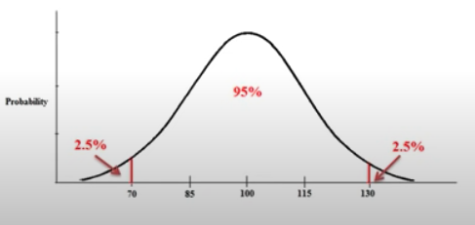
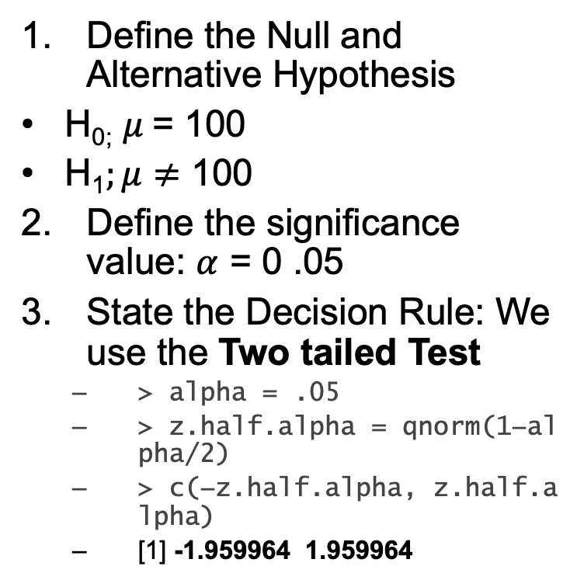
Consider IQ exam question
Define the Null and Alternative Hypothesis
H_{0;} $μ$= 100
H₁$;μ≠$ 100
Define the significance value: $α$ = 0 .05
State the Decision Rule: We use the Two tailed Test
  > alpha = .05
  > z.half.alpha = qnorm(1−alpha/2)
  > c(−z.half.alpha, z.half.alpha)
  [1] -1.959964 1.959964

Slide 24
Consider the IQ exam question
4. Calculate the test statistics.
5. State Results
Decision Rule: If Z < --1.96, or Z > 1.96 reject the null hypothesis
Z = 14.60, we Reject H₀
  Z = (x – μ) / (σ / √n)
  Z = (140 – 100)/ (15 / √30)
  Z = 14.60
Notes:
Reference:
https://www.youtube.com/watch?v=BWJRsY-G8u0

Slide 25
One sample z-test: Consider the IQ exam question
6. Conclude and interpret the result
Medication significantly affected intelligence,
z = 14.60, p < 0.05

Slide 26
The one-sample t-test
Z-Tests are commonly done when the population standard deviation is known.
T-Tests are commonly done when the population standard deviation is unknown.
Also, we use t-score when the sample size (n) < 30.
  Sample size is not large
We use the t-distribution because the unknown population standard deviation is now a value we must estimate.

Slide 27
One Sample t-test
Chalk-board Illustration.
  Z statistics vs t-statistics

Slide 28
Example one-sample t-test
In the population, the average IQ is 100. A team of scientists wants to test a new medication to see if it has either a positive or negative effect on intelligence, or no effect at all. A sample of 30 participants who have taken the medication has a mean of 140 with a standard deviation of 20. Did the medication affect intelligence? Alpha = 0.05
Steps to Answer:
Define the Null and alternative Hypothesis
  No population mean
State Alpha
Calculate Degrees of Freedom
State Decision Rule
Calculate the Test statistics
State Results
Conclude and interpret the result

Slide 29
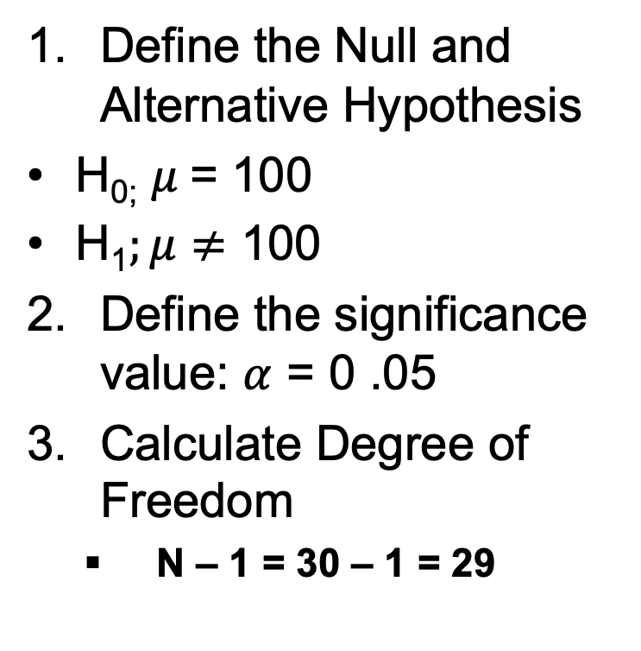
One Sample t-Test
Define the Null and Alternative Hypothesis
H_{0;} $μ$= 100
H₁$;μ≠$ 100
Define the significance value: $α$ = 0 .05
Calculate Degree of Freedom
  N – 1 = 30 – 1 = 29

Slide 30
One Sample t-Test
3. State the Decision Rule: We use the Two tailed Test
  > alpha = .05
  Check the t – distribution critical value table
  [-2.0452 2.0452]
  OR
  # Using R find two-tailed t critical values
  > qt(p=.05/2, df=29, lower.tail=FALSE)
  [1] -2.04523
Thus, if the test statistic is less than -2.04523 or greater then 2.04523, the results of the test are statistically significant.
-2.0452
2.0452

Slide 31
One Sample t-Test
4. Calculate the test statistics.
5. State Results
Decision Rule: If t < -2.0452, or t > 2.0452,then reject the null hypothesis
t = 10.96, we Reject H₀
  Z = (x – μ) / (s / √n)
  Z = (140 – 100)/ (20 / √30)
  Z = 10.96

Slide 32
One sample t-test: Consider the IQ exam question
6. Conclude and interpret the result
Medication significantly affected intelligence,
z = 10.96, p < 0.05

Slide 33
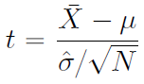
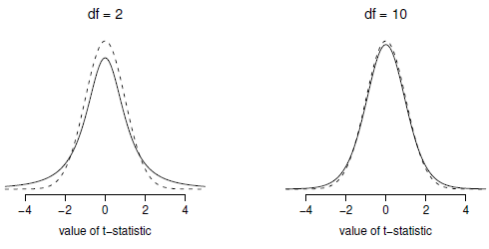
The one-sample t-test
> sd( grades )
[1] 9.520615
> install.packages("lsr")
> library(lsr)
> oneSampleTTest( x=grades, mu=67.5 )
One sample t-test
Data variable: grades
Descriptive statistics:
grades
mean 72.300
std dev. 9.521
Hypotheses:
null: population mean equals 67.5
alternative: population mean not equal to 67.5
Test results:
t-statistic: 2.255
degrees of freedom: 19
p-value: 0.036
Other information:
two-sided 95% confidence interval: [67.844, 76.756]
estimated effect size (Cohen's d): 0.504
t(19) = 2.25, p <. 05, CI₉₅ = [67.8,76.8]
Normality. We're still assuming that the population distribution is normal
Independence. We have to assume that the observations in our sample are generated independently of one another.

Slide 34
In Class Reading and Discussion
Today’s reading is Chapter 9: Hypothesis Testing
Sections 9 – 9.2
Key Reading: Understanding Hypothesis Tests
Assigned time: 30 mins. 11:15 am – 11:45 am
Review Points for discussion (11:45am - 12 pm)

Slide 35
In Class Exercise
Due at 11:59 pm
With a minimum of 250 words, in your own words, describe the key knowledge you have gained about hypothesis testing from today's lecture. The major expectation is writing clearly and concisely what you have learned from the class lecture.

